Slide 1
Project Cost/Benefit Analysis

Slide 2
Investment 1
Project as an investment.
Imagine as buy Kombi for R120 000
Incremental Cash Flow = Revenue - Costs
Year 1: R20 000 / year
Year 2: R20 000
Year 3: R20 000
…
Year 10: R20 000

Slide 3











Slide 4














Slide 5
Investment 2
Project as an investment.
Imagine as buy Kombi for R120 000
Incremental Cash Flow = Revenue - Costs
Year 1: R20 000 / year
Year 2: R18 000
Year 3: R25 000
Year 4:
Year 10: R19 000

Slide 6
Objectives
Gain an understanding of the following:
  Payback Period (PP)
  Accounting Rate of Return (ARR)
  Time Value of Money
    Net Present Value (NPV)
    Internal Rate of Return (IRR)

Slide 7





The Time Value of Money
We need an imaginary situation to understand this concept.
Imagine that there is a very safe bank which gives 10% interest every year for any money we leave there.
Imagine that I borrow R100 from you today.
When I pay you back in 1 year’s time, how much should I give you? R110

Slide 8




Slide 10


Discounting a Future Value

Slide 11





Slide 12



Slide 13
If that bank is still around, i.e., 10% per year of interest.
If I owe you R110 in one year’s time. How much should I give you now?
R100.
Calculating the PRESENT VALUE from a FUTURE VALUE is called discounting.

Slide 14
Time Value of Money
The person I borrowed from is indifferent as to whether I give them back R100 today or if given them R110 in 1 year’s time.
R100 (today) = R110 (in 1 year’s time)
Present value Future Value
Provided the annual interest rate is 10%

Slide 15
Cost/Benefit
Cost/Benefit analysis estimates and totals up the equivalent money value of the benefits and cost of projects to establish whether they are worthwhile .
There must be a common unit of measurement, and the most convenient common unit is money. This means that all benefits and costs of a project should be measured in money.
Where a factor cannot be directly measured in money, “equivalent money value” is used.

Slide 16
Cost/Benefit
The equivalent money values are based upon information derived from consumer and producer market choices; i.e., the demand and supply schedules for the goods and services affected by the project. Care must be taken to allow for such things as inflation.
When all this has been considered, a worthwhile project is one for which the discounted value of the benefits exceeds the discounted value of the costs; i.e., the net benefits are positive. This is equivalent to the benefit/cost ratio being greater than one, and the internal rate of return being greater than the cost of capital required.

Slide 17
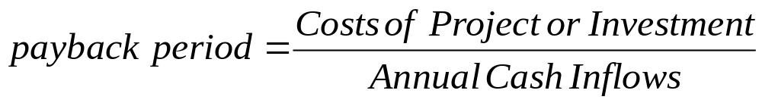
Payback Period
The payback period focuses on recovering the cost of investments. The payback period represents the amount of time that it takes for a capital budgeting project to recover its initial cost.
Payback is a rough estimate, but it presents a view of the transaction that is very understandable and important for manager.
It ignores the following:
  Any benefits that might occur after the payback period and therefore does not measure profitability.
  It ignores the time value of money.

Slide 18
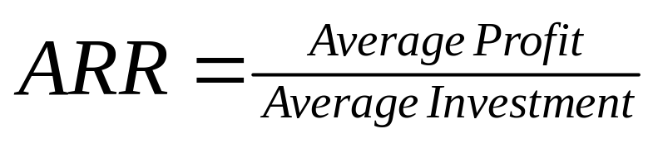
Accounting Rate of Return (ARR)
A simple rate of return
ARR is most often used internally when selecting projects. It can also be used to measure the performance of projects and subsidiaries within an organization. It is rarely used by investors, and should not be used at all, because:
  Cash flows are more important to investors, and ARR is based on numbers that include non-cash items.
  ARR does not take into account the time value of money — the value of cash flows does not diminish with time as is the case with NPV and IRR.
  It does not adjust for the greater risk to longer term forecasts.
  There are better alternatives which are not significantly more difficult to calculate

Slide 19
Time value of money
The idea that money available at the present time is worth more than the same amount available in the future, due to its potential earning capacity.
  This core principle of finance holds that, provided money can earn interest, any amount of money is worth more the sooner it is received. The “present discounted value” is the apparent present value of money available in the future. (investopedia)
For example, assuming a 5% interest rate R100 invested today will be worth R105 in one year (R100 multiplied by 1.05). Conversely, R100 received one year from now is only worth R95.24 today (R100 divided by 1.05), assuming a 5% interest rate.

Slide 20
Time Value of Money (TVM)
Time Value of Money (TVM) is an important concept in financial management. It can be used to compare investment alternatives and to solve problems involving loans, mortgages, leases, savings, and annuities.
TVM is based on the concept that a dollar that you have today is worth more than the promise or expectation that you will receive a dollar in the future. Money that you hold today is worth more because you can invest it and earn interest. After all, you should receive some compensation for foregoing spending. For instance, you can invest your dollar for one year at a 6% annual interest rate and accumulate $1.06 at the end of the year. You can say that the future value of the dollar is $1.06 given a 6% interest rate and a one-year period. It follows that the present value of the $1.06 you expect to receive in one year is only $1.
A key concept of TVM is that a single sum of money or a series of equal, evenly-spaced payments or receipts promised in the future can be converted to an equivalent value today. Conversely, you can determine the value to which a single sum or a series of future payments will grow to at some future date.
You can calculate the fifth value if you are given any four of: Interest Rate, Number of Periods, Payments, Present Value, and Future Value.

Slide 21
Present Value and Future Value
Present Value is an amount today that is equivalent to a future payment, or series of payments, that has been discounted by an appropriate interest rate. The future amount can be a single sum that will be received at the end of the last period, as a series of equally-spaced payments (an annuity), or both. Since money has time value, the present value of a promised future amount is worth less the longer you have to wait to receive it.
Future Value is the amount of money that an investment with a fixed, compounded interest rate will grow to by some future date. The investment can be a single sum deposited at the beginning of the first period, a series of equally-spaced payments (an annuity), or both. Since money has time value, we naturally expect the future value to be greater than the present value. The difference between the two depends on the number of compounding periods involved and the going interest rate.

Slide 22
Interest
Interest is a charge for borrowing money, usually stated as a percentage of the amount borrowed over a specific period of time. Simple interest is computed only on the original amount borrowed. It is the return on that principal for one time period. In contrast, compound interest is calculated each period on the original amount borrowed plus all unpaid interest accumulated to date. Compound interest is always assumed in TVM problems.
A discount rate* (also called interest rate) is the percentage by which the value of a cash flow in a discounted cash flow (DCF) valuation is reduced for each time period by which it is removed from the present.
  The estimation of a suitable discount rate is often the most difficult and uncertain part of a DCF. This is only worsened by the fact that the final result is very sensitive to the choice of discount rate — a small change in the discount rate causes a large change in the value.
* There are other definitions for the term discount rate, but we will not be using those in this course.

Slide 23
Periods are evenly-spaced intervals of time. They are intentionally not stated in years since each interval must correspond to a compounding period for a single amount or a payment period for an annuity.
Payments are a series of equal, evenly-spaced cash flows. In TVM applications, payments must represent all outflows (negative amount) or all inflows (positive amount).

Slide 24
Calculating Future Value
FV= PV ( 1 + r ) ^{N} , where
  FV = Future Value
  PV = Present Value
  r = the interest rate per period
  N= the number of compounding periods
By transposition, we have
PV = FV / ( 1 + r ) ^{N}

Slide 25
Net Present Value (NPV)
The difference between the present value of cash inflows and the present value of cash outflows
NPV analysis is therefore sensitive to the reliability of future cash inflows that a project or investment will yield.

Slide 26
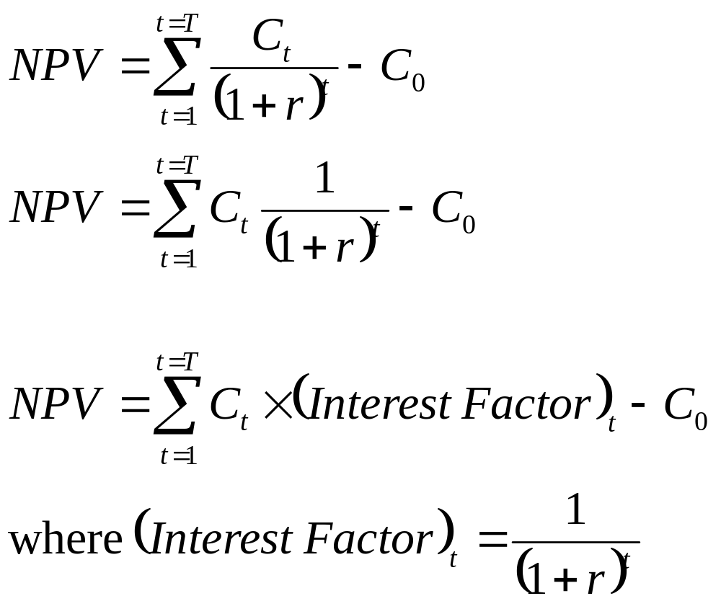
Net Present Value (NPV)

Slide 27
Internal Rate of Return (IRR)
The discount rate (“effective interest rate”) that makes the Net Present Value of all cash flows from a particular project equal to 0.
Generally speaking, the higher a project’s internal rate of return, the more desirable it is to undertake the project. In this way IRR can be used to rank several prospective projects a firm is considering. Assuming all other factors are equal among the various projects, the project with the highest IRR would probably be considered the best and would be undertaken first.

Slide 28
Sample Calculation
Consider the following spreadsheet with differing values for the discount rate
discount rate | 5%
Initial Outlay | 120000
Year(t) | Future Value | Interest Factor | Present Value
0 | -120000 | 1.0000 | -120000.00
1 | 20000 | 0.9524 | 19047.62
2 | 20000 | 0.9070 | 18140.59
3 | 20000 | 0.8638 | 17276.75
4 | 20000 | 0.8227 | 16454.05
5 | 20000 | 0.7835 | 15670.52
6 | 20000 | 0.7462 | 14924.31
7 | 20000 | 0.7107 | 14213.63
8 | 20000 | 0.6768 | 13536.79
9 | 20000 | 0.6446 | 12892.18
10 | 20000 | 0.6139 | 12278.27
 |  | Total (NPV) | 34434.70

Slide 29
At 10%
discount rate | 10%
Initial Outlay | 120000
Year(t) | Future Value | Interest Factor | Present Value
0 | -120000 | 1.0000 | -120000.00
1 | 20000 | 0.9091 | 18181.82
2 | 20000 | 0.8264 | 16528.93
3 | 20000 | 0.7513 | 15026.30
4 | 20000 | 0.6830 | 13660.27
5 | 20000 | 0.6209 | 12418.43
6 | 20000 | 0.5645 | 11289.48
7 | 20000 | 0.5132 | 10263.16
8 | 20000 | 0.4665 | 9330.15
9 | 20000 | 0.4241 | 8481.95
10 | 20000 | 0.3855 | 7710.87
 |  | Total (NPV) | 2891.34

Slide 30
At 12%
discount rate | 12%
Initial Outlay | 120000
Year(t) | Future Value | Interest Factor | Present Value
0 | -120000 | 1.0000 | -120000.00
1 | 20000 | 0.8929 | 17857.14
2 | 20000 | 0.7972 | 15943.88
3 | 20000 | 0.7118 | 14235.60
4 | 20000 | 0.6355 | 12710.36
5 | 20000 | 0.5674 | 11348.54
6 | 20000 | 0.5066 | 10132.62
7 | 20000 | 0.4523 | 9046.98
8 | 20000 | 0.4039 | 8077.66
9 | 20000 | 0.3606 | 7212.20
10 | 20000 | 0.3220 | 6439.46
 |  | Total (NPV) | -6995.54

Slide 31
Clearly the Internal Rate of Return lies somewhere between 10% and 12%. Trial and error, or the use of a spreadsheet formula will yield the correct result.
discount rate | 10.55795%
Initial Outlay | 120000
Year(t) | Future Value | Interest Factor | Present Value
0 | -120000 | 1.0000 | -120000.00
1 | 20000 | 0.9045 | 18090.06
2 | 20000 | 0.8181 | 16362.51
3 | 20000 | 0.7400 | 14799.94
4 | 20000 | 0.6693 | 13386.59
5 | 20000 | 0.6054 | 12108.21
6 | 20000 | 0.5476 | 10951.92
7 | 20000 | 0.4953 | 9906.04
8 | 20000 | 0.4480 | 8960.04
9 | 20000 | 0.4052 | 8104.39
10 | 20000 | 0.3665 | 7330.44
 |  | Total (NPV) | 0.16

Slide 32
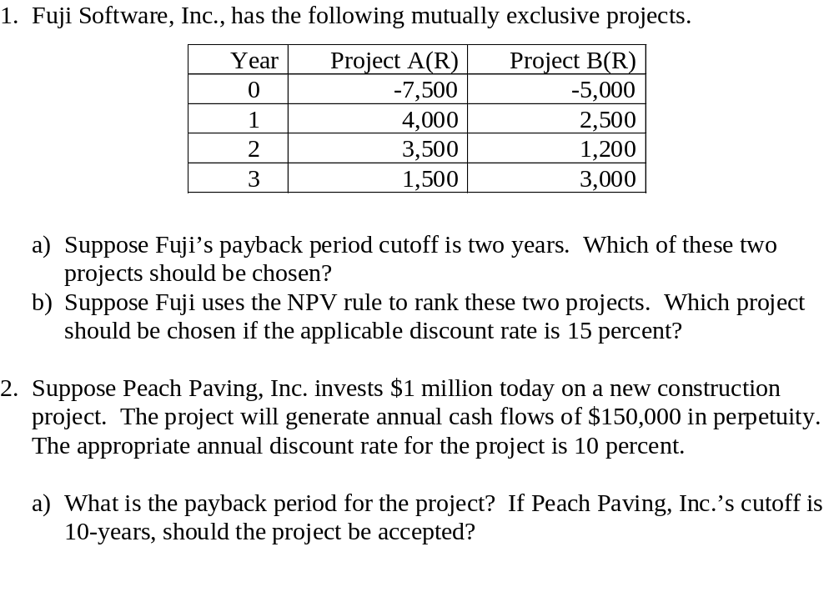
Two Exercises

Slide 33
Compound Interest
We have only dealt with interest compounded annually. In many situations, interest is compounded monthly instead, or perhas quarterly. A different formula is used in such situations.
FV= PV ( 1 + r/n ) ^{nN}
  FV = Future Value
  PV = Present Value
  r = the interest rate per period
  N= the number of compounding periods
  n = number of compounding periods per year

Slide 34

Interpolation for the IRR

